Slide 1
Real-time Applications On Event Driven Architecture

Slide 2
Cloud
Event Driven Architecture
Horizontally Scalable
Multiple screens
Multiple small transactions
Open Source
Real-time
Responsive
Time to market
…..
Application Development Trends

Slide 3
Client A
Client B
Client C
Web Server
Thread 1
Thread 2
Thread 3
Database
1
3
4
5
6
7
8
9
10
2
Time (sec)
1 | 2 | 3 | 3 | 3 | 2 | 1 | 1 | 1 | 1
Active Threads
Traditional
Evented

Slide 4
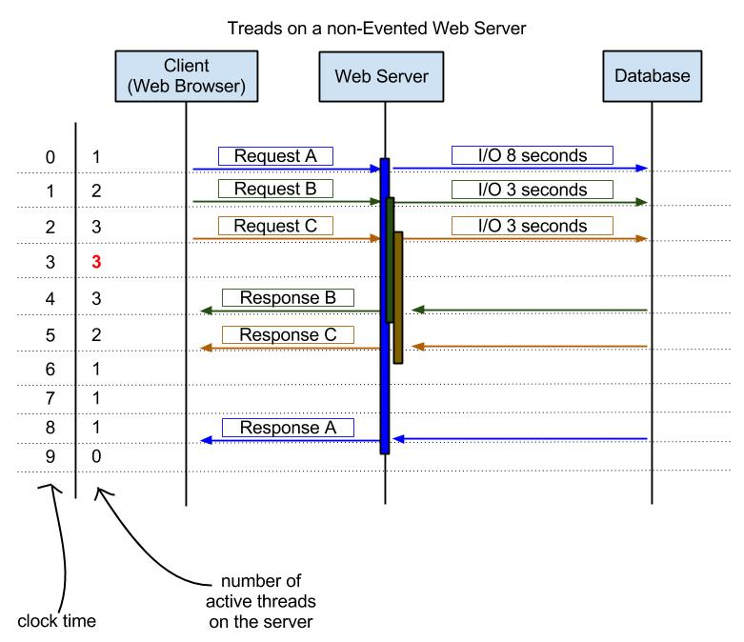
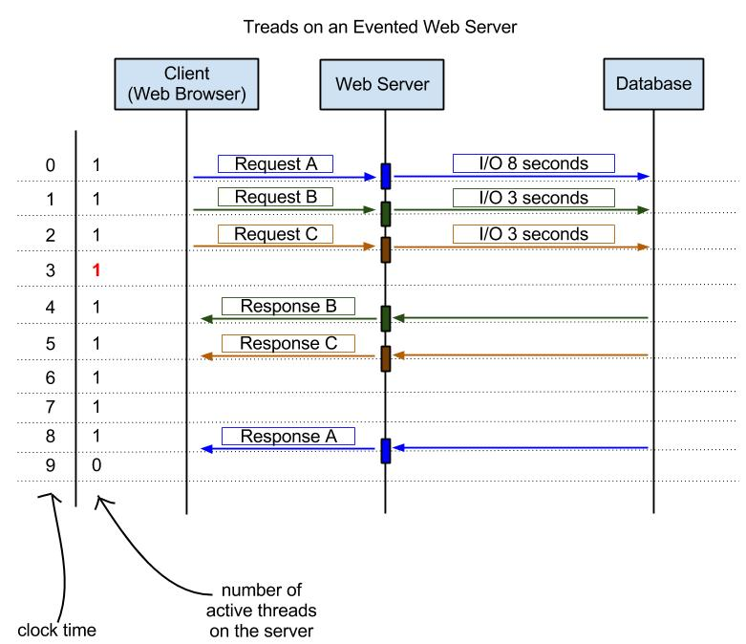
Traditional
Evented
LEAN?

Slide 5
libuv
NodeJS
V8
js,
C++
NodeJS components

Slide 6

Real-time
Concurrency Support
Horizontal Scalability
Time to market
Event Driven
Open Source

Slide 7

Real-time
Cross-Browser
Bi-directional communication
Horizontal Scalability
Time to market
Open Source

Slide 8

Horizontal Scalability
Time to market
Flexible Schema
Auto-Sharding
Dynamic queries
Open Source

Slide 9
CODE
MongoDB NodeJS Setup
MongoDB*
NodeJS
NPM
SocketIO
MongoDB Native Driver

Slide 10
CODE
MongoDB Example

Slide 11

Solution that that shows appropriate ad to appropriate viewer, based on various viewer traits.
Ad Request +
Profile/ traits
Ad Viewer
Ad Server
Ad Server

Slide 12
CODE
Socket.IO – NodeJS Example

Slide 13
CODE
Solution

Slide 14
Service Bus on Azure
Use RedisStore Publisher and SockeIO subscribers
Methods for Scale-out Implementation

Slide 15
Questions

Slide 16
Thank you !!
Tejas@GeNeura.com

Slide 17
SocketIO
// send to current request socket client
socket.emit('message', "this is a test");
// sending to all clients, include sender
io.sockets.emit('message', "this is a test");
// sending to all clients except sender
socket.broadcast.emit('message', "this is a test");
// sending to all clients in 'game' room(channel) except sender
socket.broadcast.to('game').emit('message', 'nice game');
// sending to all clients in 'game' room(channel), include sender
io.sockets.in('game').emit('message', 'cool game');
// sending to individual socketid
io.sockets.socket(socketid).emit('message', 'for your eyes only');
Tejas@GeNeura.com

